Slide 1
Cognitive Computation based Stock Analysis and Pseudo-Stock System [UniStock]
CSE4059- Cognitive Systems
Mainak Sengupta(19BLC1022)

Slide 2
Problem Statement
With the rapid rise of startups, people often need to find how viable a product idea is and how much public favor it can gather with respect to the idea implementation. There is a need to gather public valuation without actual use of money.
There is also a need from the younger generation to learn stock trading but lack of a safe platform to get experience from initially.

Slide 3
Abstract
The goal is to create a one stop solution to allow startup ideas to pitch their ideas, which will be evaluated using market standards, tech trends and other metrics.
Users will be able to invest in said ides via points, which will also allow newcomers to have exposure to stock trading in a healthy manner.
This will also serve as a standpoint to find other like minded people.

Slide 4
Features
Graph trends to show potential growth of trend
ML algorithm to valuate a stock based on tagging and Key Words search on Market Analysis
Allowing start-ups to view initial valuation(base valuation) as well as public reaction to said idea.

Slide 5

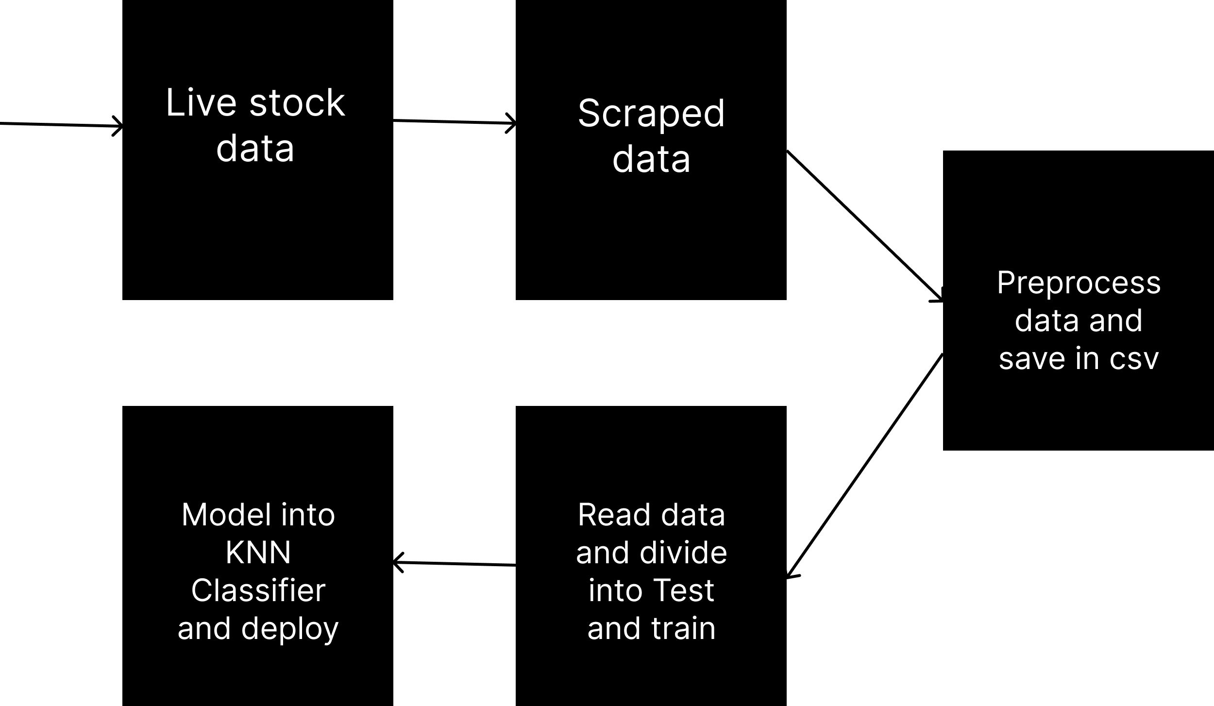
Architecture Diagram

Slide 6
Dataset
Dataset is dynamically generated using a scraper to scraper live data from stock market analysis.
The dataset contains information about leading companies growth rate, stock price and which sector they belong to.
The Dataset will also be influenced by external factors like news and other factors

Slide 7
Algorithm
Our main algorithm is a Classification algorithm to classify the stock in a specific sector first to detect its potential growth rate
After that we use LTSM analysis to calculate the stock price of the stock
Since the dataset is dynamic in nature, our price cap and gains change every day.
The Algorithm will also allow prediction of price based on growth rate, but this price will only be applicable for the next day when the stock market reopens.
There is also a Sentiment Analysis Module for calculating the probability of a agriculture company’s stock rising using search results.

Slide 8
Modules
Beautifulsoup4 for scraping real time data
KNN classifier for prediction and analysis
Minowski metric with Euclidean distance for KNN algorithm
LTSM module for predicting growth or fall for stocks
WordCloud and NLTK Sentiment analysis module for Company Stock prediction

Slide 9
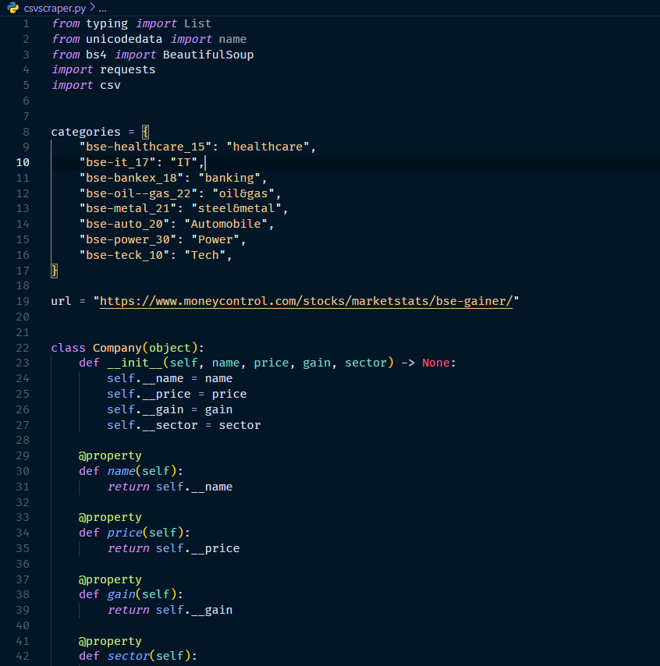
Implementation

Slide 10
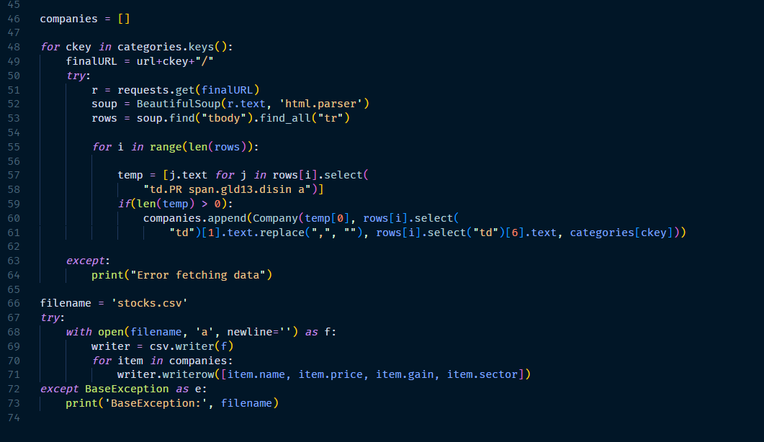
Implementation

Slide 11
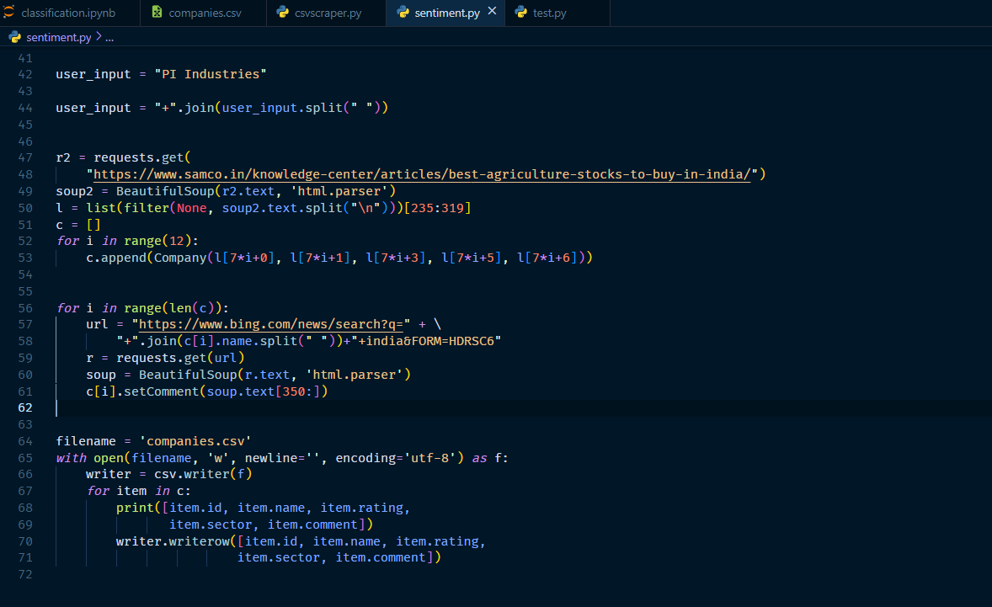
Implementation

Slide 12
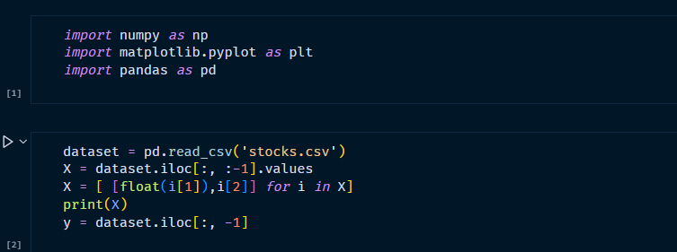
Implementation

Slide 13
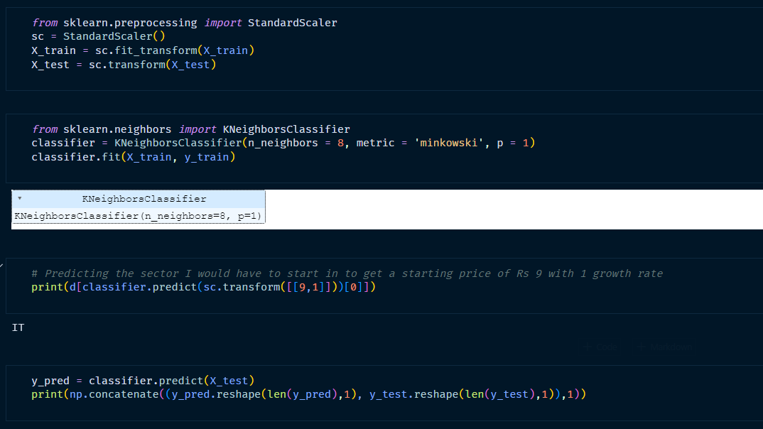
Implementation

Slide 14
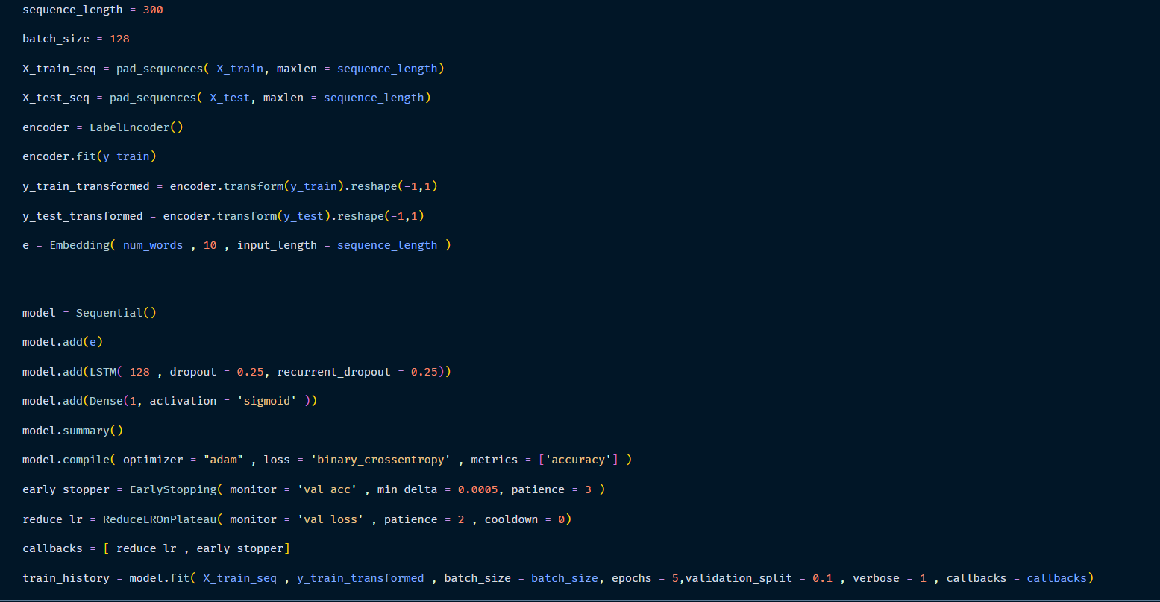
Implementation

Slide 15
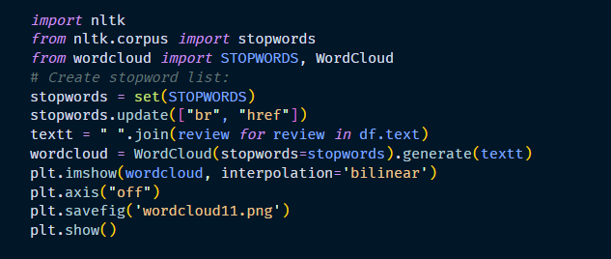
Implementation

Slide 16
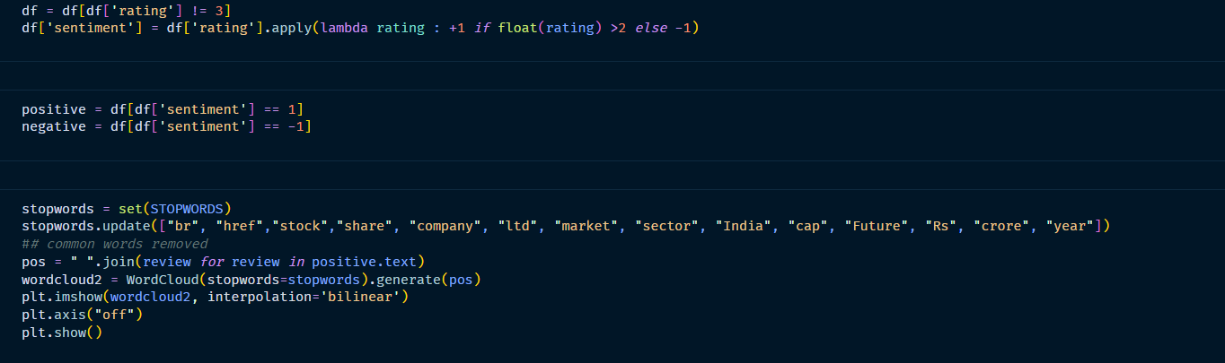
Implementation

Slide 17
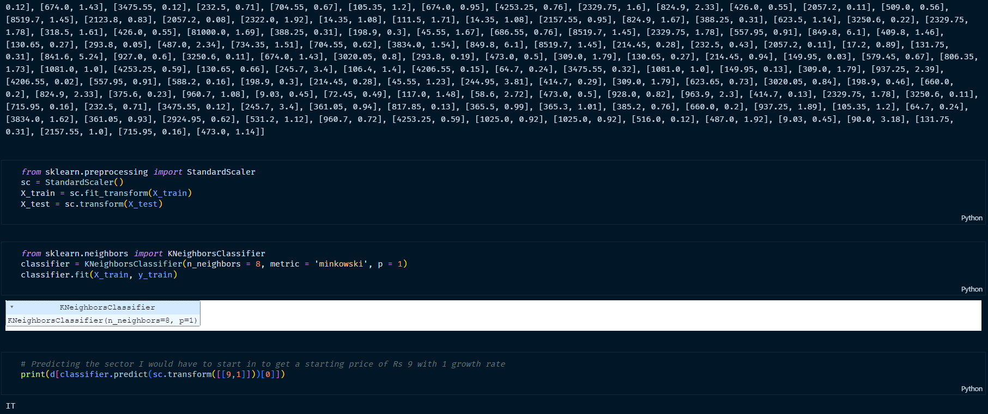
Results

Slide 18
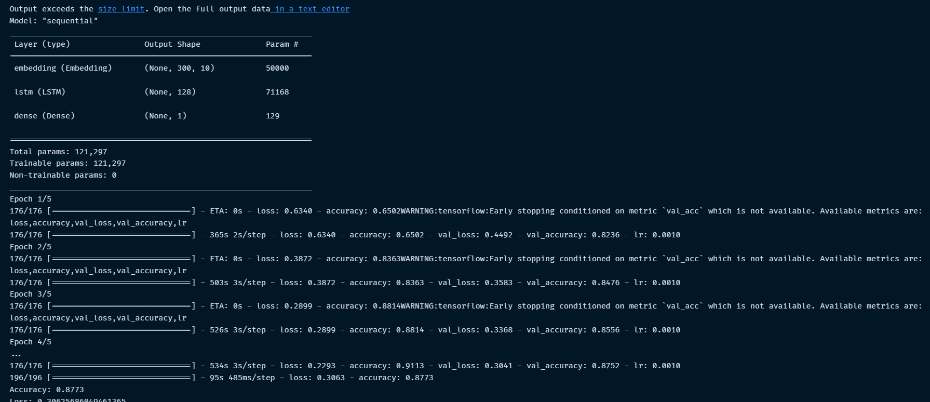
Results

Slide 19
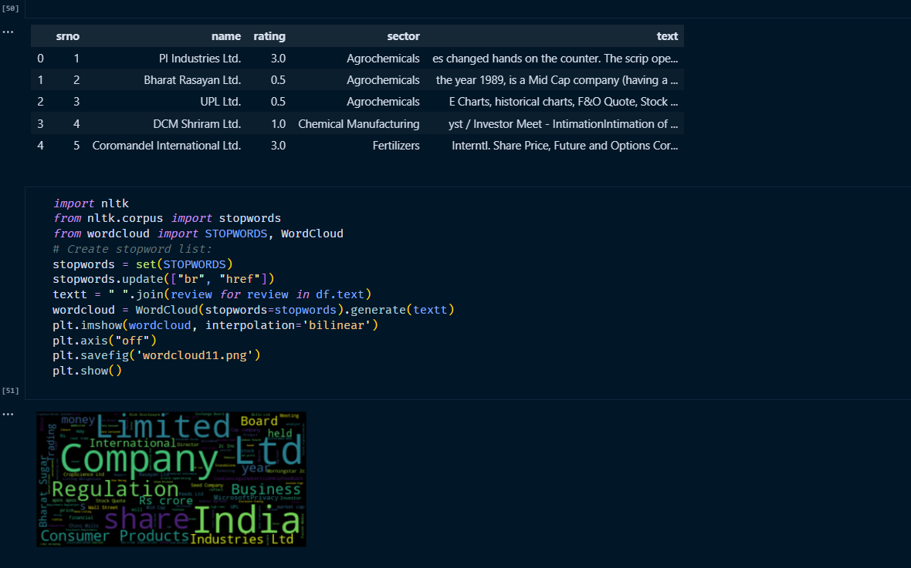
Results

Slide 20
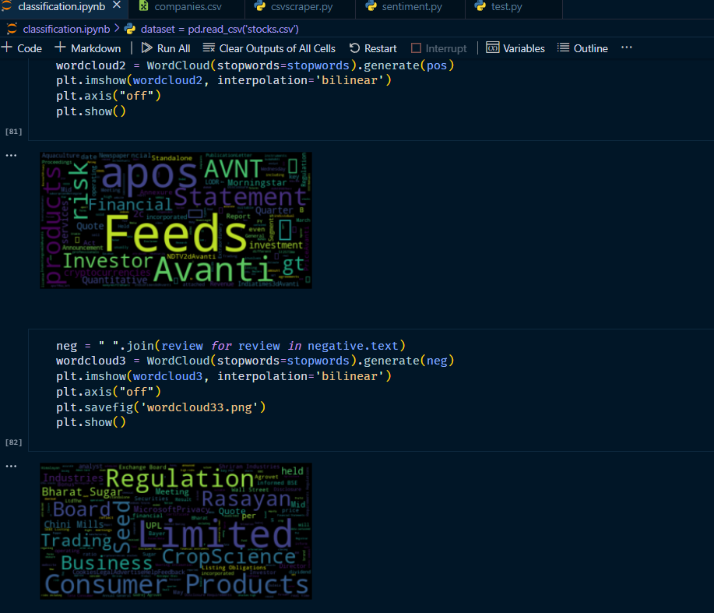
Results

Slide 21
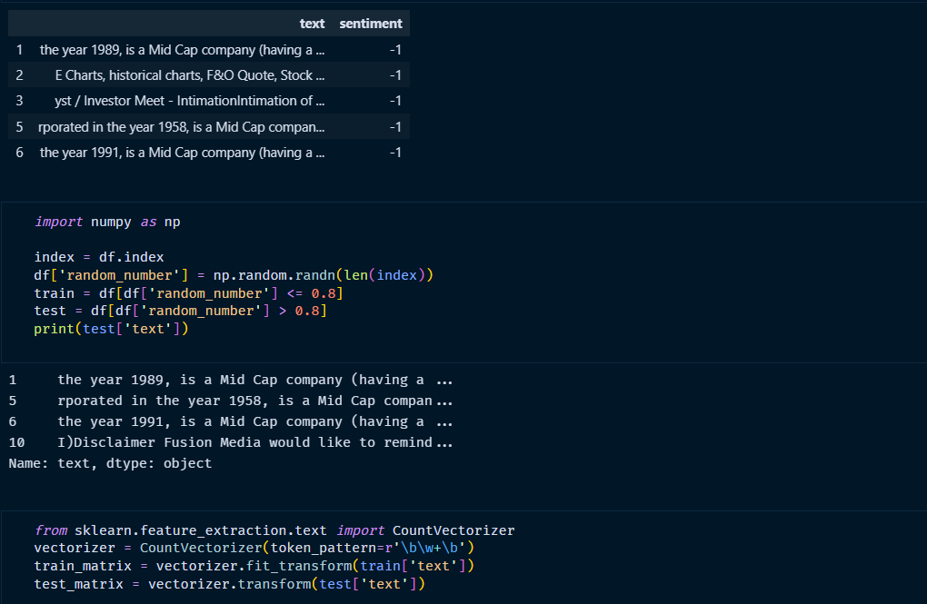
Results

Slide 22
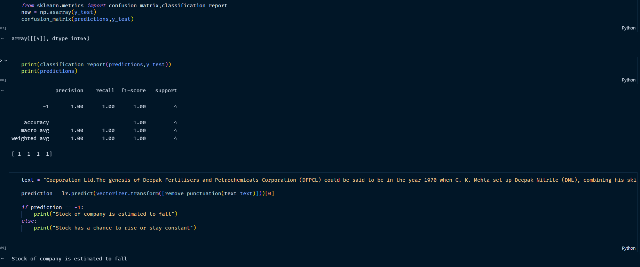
Results

Slide 23
Results
Successfully created a cognitive model to adapt to market changes, predict stock market using LTSM and Sentiment Analysis
Evaluated results and compared against actual results live from online tables

Slide 24
Comparison with existing products
Model is still less accurate than existing product on market due to infancy
Model gives more valuable and to the point results as compared to other products which give a statistic
Works in real time like many other models, albeit a bit slower due to inefficient free data retrieval stream

Slide 25
Future Work
Add a Proper UI for user benefit and ease of use
Create proper visualization and make our model stronger and have it fit better to adjust to changes in the market
Have better UX and more inquisitive models and results for users to properly use and take advantage

Slide 26
Reference Papers
Cognitive Intelligence based Expert System for Predicting Stock Markets using Prospect Theory
Cognitive abilities and stock market participation of individual investors during the financial crisis

